Slide 1


Oral Communication Skills A
(CELEN069)
Lesson 11.1

Slide 2
Lesson aims and objectives
By the end of this lesson, you should have enhanced your speaking and listening ability through practice.
In addition, you should be better able to … | Intended Learning Outcomes
reflect on own learning experiences | 1.1 1.3 1.6 2.5 3.6
create revision tools for assessments
recall key information from core unit topics for the group discussion exam

Slide 3

Getting started

Slide 4
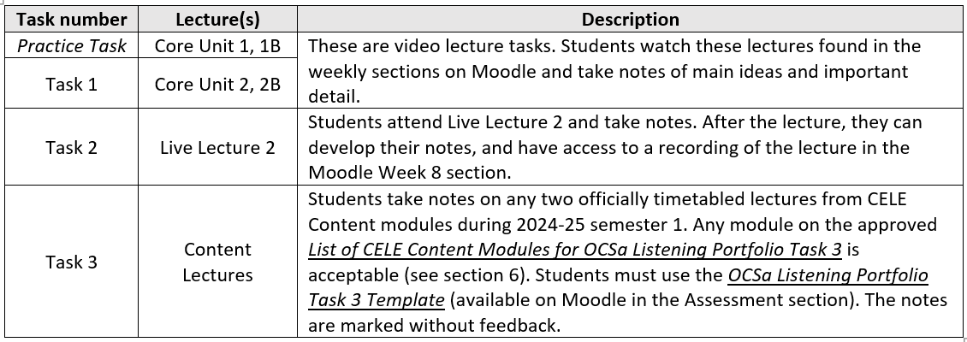
Getting started
Listening Portfolio Task 2 asked you to submit notes for Live Lecture 2.
What do you think was the purpose of the task?

Slide 5
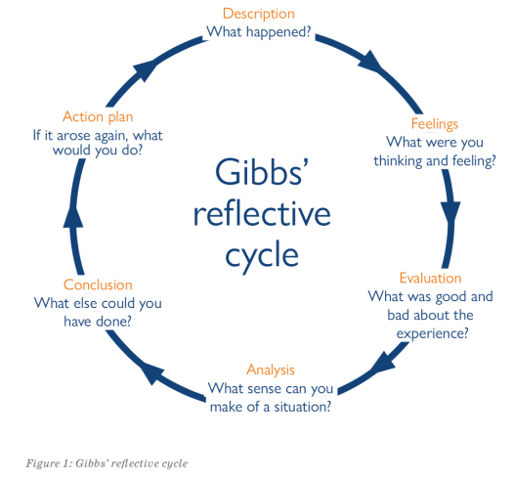

Getting started
Now, use the reflective model on p.53 in the Class Workbook to help you consider your performance on the task.
Using a reflective model can help you organise your thoughts as you think back on something you did and how it will help in your future.

Slide 6
Getting started
The purpose of Listening Portfolio Task 3 is to provide an opportunity for you to transfer and apply the skills from OCSa to wider academic contexts.
Taking notes in lectures is extremely important as it can help you engage with the topic better. On your future modules, you should try to apply the note-taking skills you learned in OCSa.
The notes for Listening Portfolio Task 3 must be submitted to Moodle by Week 12, Monday 16th December, 3pm.

Slide 7

Revising your notes

Slide 8
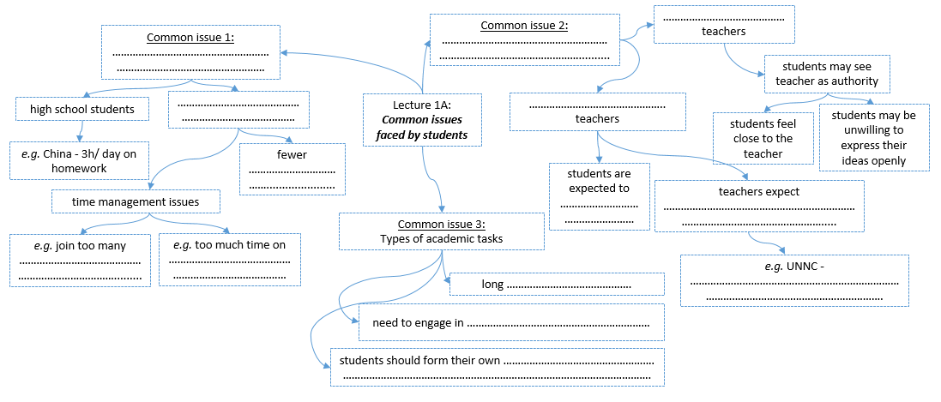
Revising your notes: Mind mapping
Revising
One way of revising for an exam is by re-writing your notes into a new format, such as creating a mind map.
Use the notes you took for Lecture 1A: Common issues faced by students to complete the mind map on the worksheet.

Slide 9
Revising your notes: Mind mapping
students may see teacher as authority
Common issue 2:
Student-teacher relationships
Chinese school teachers
Compare your own mind map with the one below.
students feel close to the teacher
students may be unwilling to express their ideas openly
Common issue 1:
Unstructured time
Lecture 1A:
Common issues faced by students
Western university teachers
high school students
e.g. China - 3h/ day on homework
Common issue 3:
Types of academic tasks
university students
students are expected to be active
teachers expect opinions - evidence of student engagement
time management issues
fewer mandatory classes
long assignments
need to engage in research - extensive reading
e.g. UNNC - by the end of Sem 1, students understand the need to be independent
e.g. join too many clubs/ societies
e.g. too much time on video games
students should form their own ideas and opinions, supported by research

Slide 10
Group Discussion Exam
(Prompt format)

Slide 11
Group Discussion Exam: Prompt format
During the Group Discussion Exam, the task will require you to agree on certain features of a topic and rank them in order of importance. You will need to try to reach a consensus as a group.
agree on
topic
Agree on: benefits / drawbacks / similarities / differences / etc.
Agree on 2-3 ways to improve speaking and listening skills.
Rank them starting with the most effective.
rank
Topic: the video lectures from the six Core Units on the course
This prompt is similar to the final Group Discussion Exam.
Rank them starting with the most important / significant / etc.
Create a possible exam prompt based on the contents from Lecture 1A. Use the mind map to help you.

Slide 12
Practice

Slide 13
Group Discussion Exam: Practice
Have a group discussion based on the prompt you created.
agree on
topic
Agree on 2-3 ways to improve speaking and listening skills.
Rank them starting with the most effective.
rank

Slide 14
Review

Slide 15
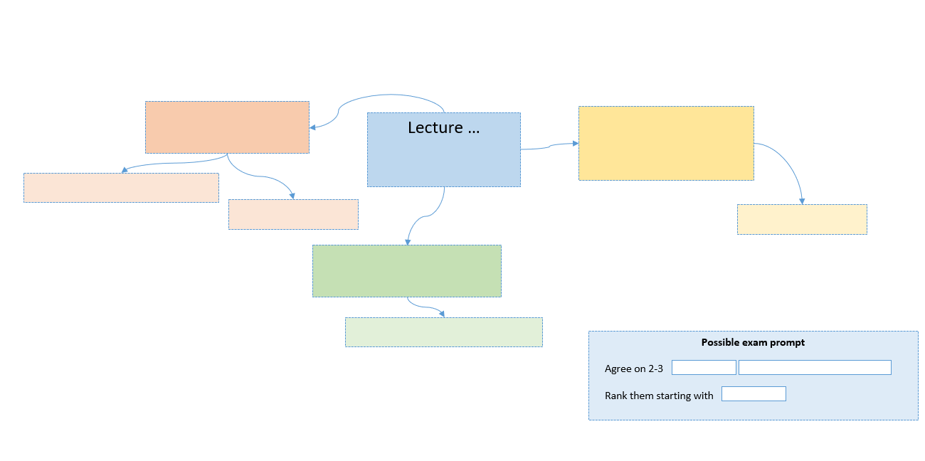

Review
You will be assigned one of the Core Unit lectures. Work in pairs/groups to create a mind map based on the content of the lecture assigned to you. Then create a possible exam prompt for the same lecture.
1A: Common issues faced by students
1B: Strategies for overcoming common issues
2A: Understanding stress
2B: Technology and mental health
3A: Language learning: Affective factors
3B: Learning differences: How they affect language learning
4A: Language change: Good, bad or inevitable?
4B: Endangered languages
5A: Social media in education
5B: Technology and sedentary lifestyles
6A: The current state of artificial intelligence
6B: Issues with AI

Slide 16
Review
Use your class Team to share the mind map and prompt you created.
You will use these prompts in the Friday lesson.

Slide 17
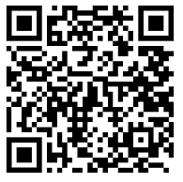
End of semester feedback
Student Evaluation of the Module (SEM) Provide feedback on the module. This refers to the content and materials used on the course.
https://bluecastle-cn-surveys.nottingham.ac.uk

Slide 18
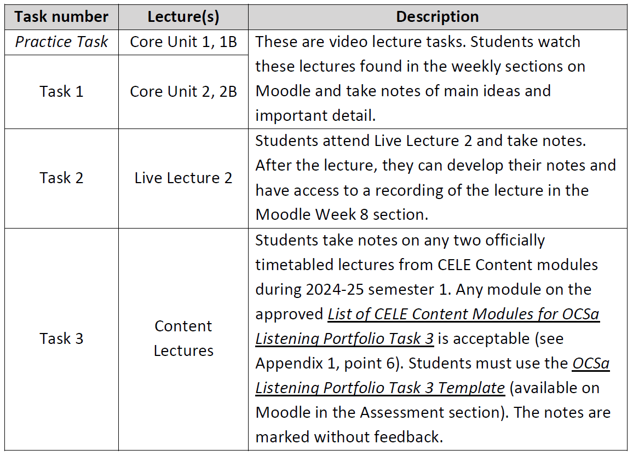
Reminder
Next week you have to submit your Listening Portfolio Task 3
by Monday 16th December 3pm to Moodle (Assessment section).

Slide 19
Homework
Due | Task
Lesson 11.2 | Read one text from Moodle related to the lecture you created a mind map for. Add more information to the mind map based on the ideas from the text. Share a photo of the mind map and the exam prompt in the class Team.

